Slide 1
Advanced Understanding of Statistical Models for ML
Kevin Ford
kevinf@magenic.com
617 359-5192

Slide 2
https://github.com/Magenic/MMLStatisticalModelsForML
https://www.amazon.com/Machine-Learning-Absolute-Beginners-Introduction-ebook/dp/B07335JNW1?ie=UTF8&redirect=true&ref_=ku_mi_rw_edp

Slide 3
How do All the Pieces Fit Together?
Run through by number of epochs
Training Data
Layer calculation with neurons
Activation function applied to neurons
Layer calculation with neurons
Activation function applied to neurons
Calculate loss
Optimizer adjusts weights (backpropagation)
Kernel / weights
Validation data
Leaning rate

Slide 4
Focus of Class – Model Shapes and Hyper Parameters
What are the different loss functions?
Layer type?
Activation Function?
Kernel (weights)?
How to handle bias?
How many layers?
How many neurons?
How many epochs?
What optimizer should I use?
Batch size?

Slide 5
Gradient Descent
“To explain in brief about gradient descent, imagine that you are on a mountain and are blindfolded and your task is to come down from the mountain to the flat land without assistance. The only assistance you have is a gadget which tells you the height from sea-level.”
https://towardsdatascience.com/gradient-descent-in-python-a0d07285742f#:~:text=To%20explain%20in%20brief%20about%20gradient%20descent%2C%20imagine,gadget%20which%20tells%20you%20the%20height%20from%20sea-level.
Size of Steps took in any direction = Learning rate
The direction of your steps = Gradients
Current height = Cost function
The bottom is called the Global Minimum

Slide 6
Optimizers
Optimizers determine the direction of the steps
The learning rate set for the optimizer states how much to step
Partial derivatives (gradients) tell how much a change to a single weight impacts the total loss
Calculate Loss
Current
Weight
Partial Derivative
Optimizer
Calculate New Weight
Weight
Weight
Weight
Weight
Weight
Weight
Gradient - slope of the error for a specific weight and thus how much a changes to a weight impacts the total loss
Chain Rule – A single weight change may cascade through the model, through several layers

Slide 7
The problem with Loss
No one minimum, many local minimums
The wrong step size may result in model stuck in local minimum
Good optimizer balances two concerns
Arrives at global minimum as fast as possible
Does not get stuck in a local minimum
Momentum idea created to help reduce chance of getting stuck
Can “roll over” local minimum valleys

Slide 8
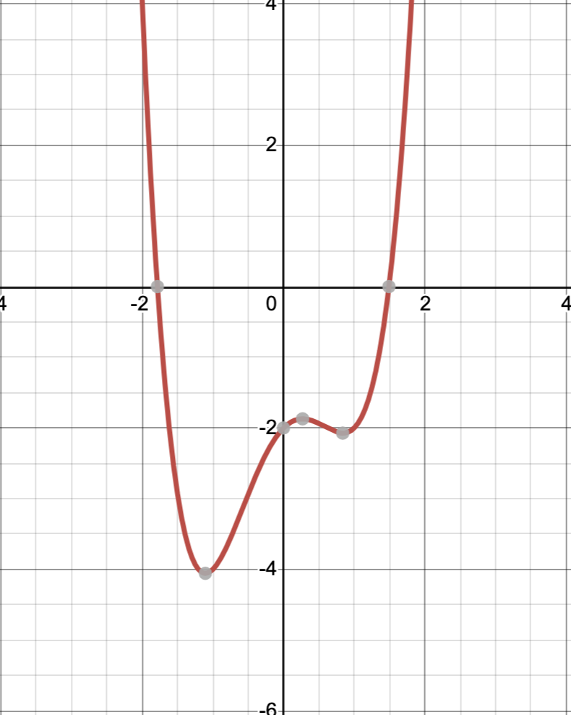
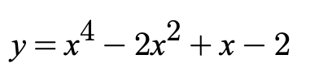
Example of Local vs Global Minimum
Big Step Size and descent won’t get stuck, but may not make it to full global minimum
Small step size and decent can get stuck on local minimum
Some optimizers have a concept of momentum that adjust step size to not get “stuck” but find global minimum
Local Minimum
Global Minimum

Slide 9
SGD - Stochastic Gradient Descent
tf.keras.optimizers.SGD
All weights share the same learning rate, rate needs to be set
Uses a random mini batch to calculate adjustments
Use when there is a lot of data, too much to store in memory
Movement can be very chaotic
Can also add momentum by setting it to a parameter other than zero
Usually takes more iterations to reach minimum but each iteration can be very fast due to the mini batch

Slide 10
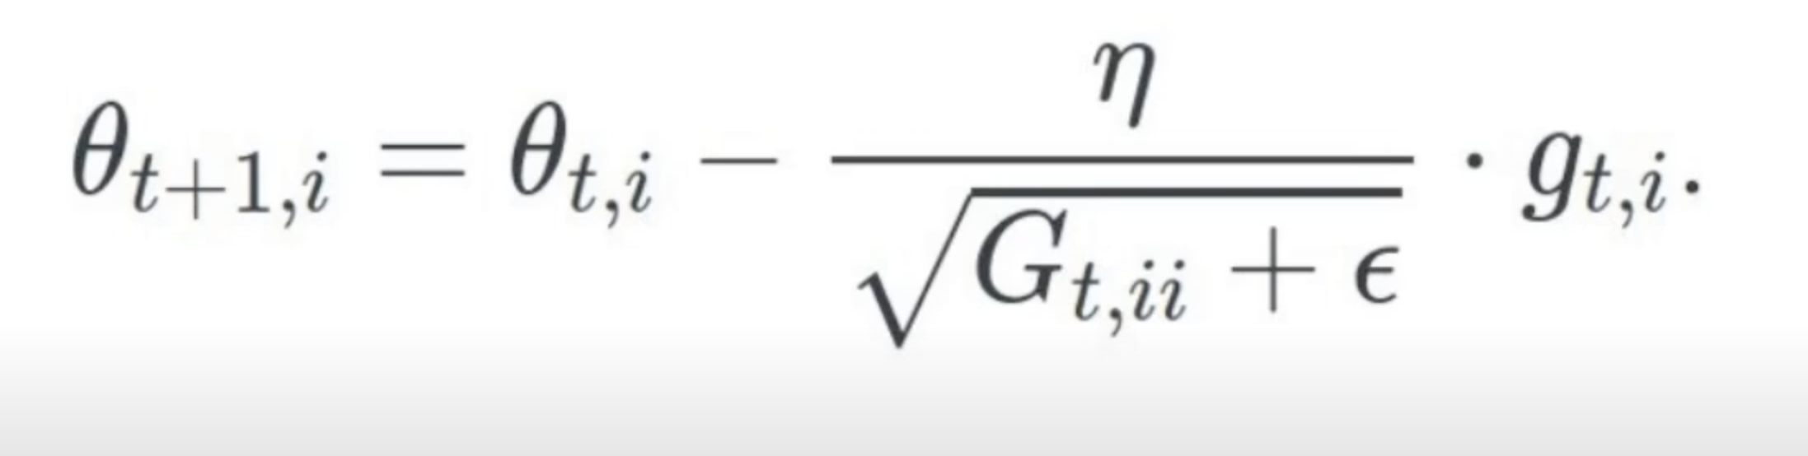
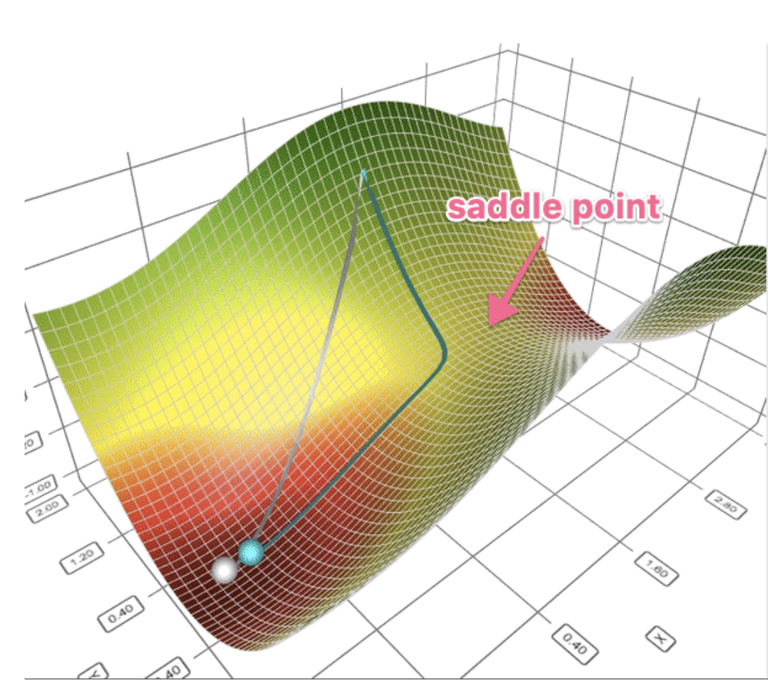
Adagrad - Adaptive Gradient
tf.keras.optimizers.Adagrad Similar to SGD
Low learning rate for frequent feature
Large learning rate for infrequent features
Different learning rate for every parameter
Excels when using sparse data
Automatically adjusts learning rate
Over time, learning rate can become infinitesimally small due to accumulating sum of all past gradient updates squared

Slide 11
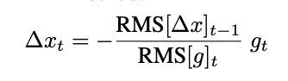
Adadelta – Adaptive Delta
tf.keras.optimizers.Adadelta Expands on Adagrad
Uses shifting window for accumulating past gradient updates
Decaying average of all past squared gradients.
Does not require an initial learning rate (but Keras allows it)
If Adagrad stops learning, consider Adadelta

Slide 12
RMSProp - Root Mean Square Propagation
tf.keras.optimizers.RMSprop Expands on Adagrad, alternative to Adadelta
Centered version shifting window for accumulating past gradient updates
Exponentially decaying average of squared gradients
Does not require an initial learning rate (but Keras allows it)
Slows down momentum when nearing minima
Also consider if Adagrad stops learning

Slide 13
Adam - Adaptive Moment Optimization
tf.keras.optimizers.Adam
Common optimizer to start with
Combines pure momentum with Adagrad feature learning rate adjustments
One of the most computationally efficient
SGD with momentum on object recognition, character-level language modeling, and constituency parsing usually superior

Slide 14
Hyperparameter Auto-Tuning
Can automate experiments to tweak hyper-parameters
Need to use TensorBoard
Start a new bash session in new window
docker container exec -it {container id} bash
Clear out any existing logs
!rm -rf {location of logs}
Start tensorboard in bash prompt
tensorboard --logdir={location of logs} --bind_all
Browse to tensorboard on host machine
http://127.0.0.1:6006/

Slide 15
Steps to Setup Auto-Tuning
Define parameters you want to tune using HParam
HP_OPTIMIZER = hp.HParam('optimizer', hp.Discrete(['adam', 'sgd', 'RMSprop']))
Create function that takes hyper-parameters as function parameters
Run through all hyper parameters in a loop running training function for each hyper-paramter
for num_units in HP_NUM_UNITS.domain.values:
for dropout_rate in (HP_DROPOUT.domain.min_value, HP_DROPOUT.domain.max_value):
tf.keras.backend.clear_session()
gc.collect()
Log results
Compare results in Tensorboard

Slide 16
Demo 1: Playing with optimizers

Slide 17
Homework reading
Book Chapters 9-15
https://ruder.io/optimizing-gradient-descent/
https://ruder.io/deep-learning-optimization-2017/index.html#improvingadam
https://heartbeat.fritz.ai/an-empirical-comparison-of-optimizers-for-machine-learning-models-b86f29957050
https://www.geeksforgeeks.org/ml-stochastic-gradient-descent-sgd/
https://www.youtube.com/watch?v=EGt-UOIIdDk
https://towardsdatascience.com/a-visual-explanation-of-gradient-descent-methods-momentum-adagrad-rmsprop-adam-f898b102325c
https://blog.paperspace.com/intro-to-optimization-momentum-rmsprop-adam/

Slide 18
Homework assignment
Experiment with different optimizers, including ones that I have not covered: Adamax, Ftrl, Nadam.

Slide 19
Q & A
New week – optimizing our model

